Slide 1
eBucs Approval Training

Slide 2
“My Approvals”
After logging in you will see the eBucs home page
Click Orders and Documents found on the left-side
ribbon menu (third icon from the top)
Find and click My Approvals
You may want to bookmark My Approvals for quick access
To bookmark a page, click the Star on the top right beside your name
When the drop-down menu shows, click Bookmark this page
Your bookmarked pages are saved under the star

Slide 3
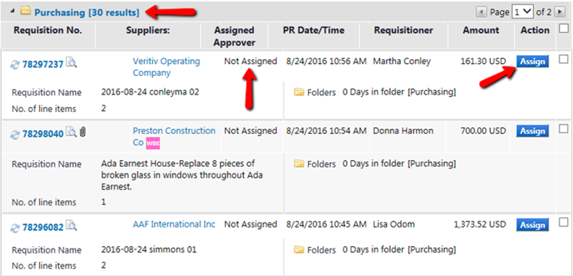
Assigning a Requisition to Yourself
Once you are in My Approvals, you will see the requisition(s) pending for your approval
The requisition will first appear in a shared department folder unassigned to anyone
To assign yourself a requisition, click the Assign button on the far right

Slide 4
Reviewing the Requisition
When you assign yourself a requisition, it will show in your My PR Approvals folder. This allows only you to work on the requisition
You can only approve or reject the requisition (or specific items) when the requisition is in My PR Approvals
To review the requisition before you approve or reject, click the blue requisition number

Slide 5
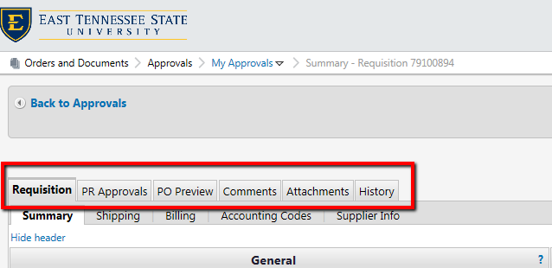
Reviewing: Requisition Tabs
A requisition is made up of 6 sections:
Requisition Summary
PR Approvals
PO Preview
Comments
Attachments
History
You can access a specific section of the requisition by clicking on the respective tab

Slide 6
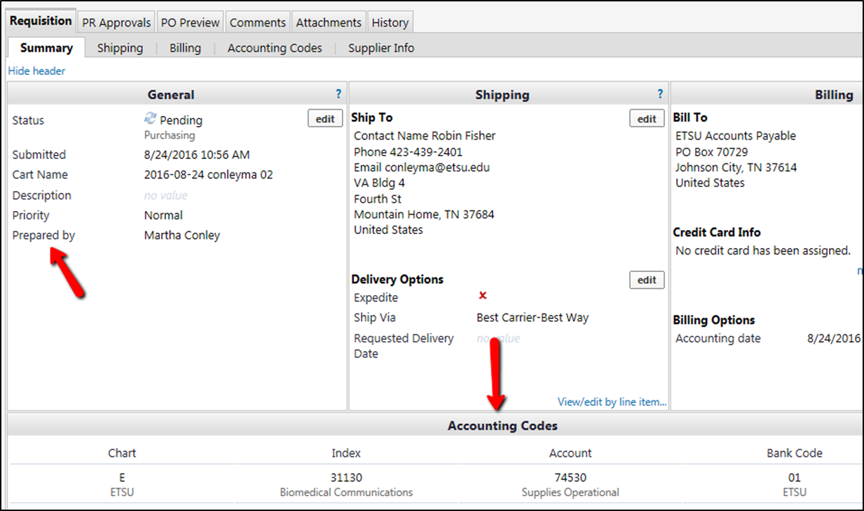
Reviewing: Requisition Summary Tab (Header)
On the requisition summary header you can view:
The date the requisition was submitted
Who prepared the requisition (Prepared By)
Shipping and billing info
Under Accounting Codes, you can see what index and account code are being used for the requisition

Slide 7
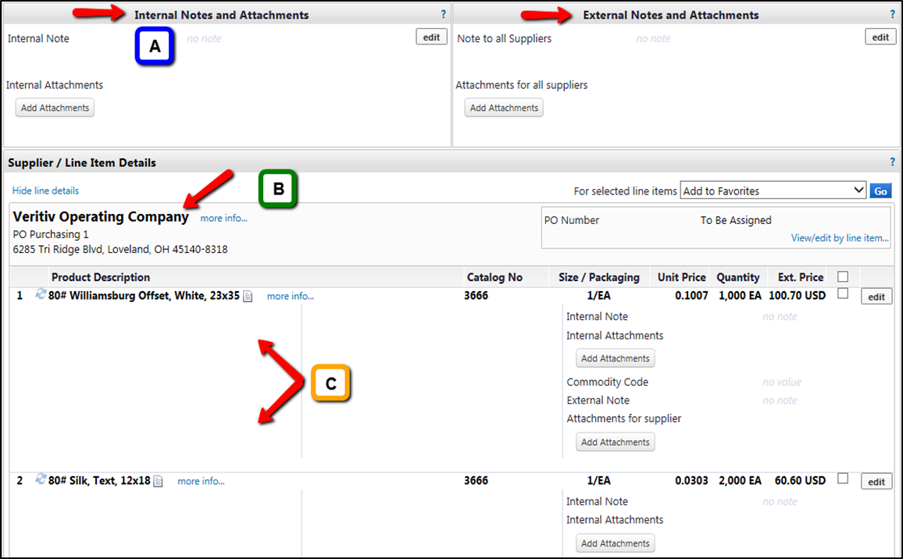
Reviewing: Requisition Tab (Lower Portion)
On the lower portion of the requisition summary you can view:
Internal/External notes and attachments (A)
Supplier info (B)
Line items – product/service details (C)
Internal notes & attachments are only visible internally, meaning only ETSU eBucs users can see them
External notes & attachments are visible internally as well as externally to the supplier
An approver may also add notes/attachments if the requisition is assigned to them.
To add a note/attachment, click the edit button in those sections
Note: Only PDF and Word Docs are able to be attached

Slide 8
Reviewing: PR Approvals Tab (Workflow)
Requisitions go through a series of approvals before they are issued a PO number. This is called the Workflow.
The PR Approvals tab will show you where the requisition is pending approval in the workflow
Depending on what the requisition is for, there may be more or less approval steps in the workflow
You can also view who the approver(s) are in a specific workflow step by clicking “view approvers”

Slide 9
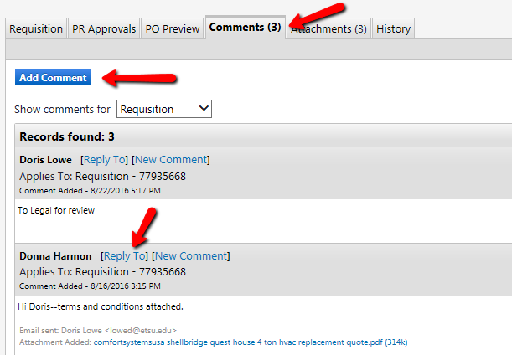
Reviewing: Comments Tab
Comments can be viewed and added to a requisition on the Comments tab
Click “Add Comment” to add a new comment
To reply to another user’s comment, click “Reply To”
You do not have to be assigned to the requisition to add a comment

Slide 10
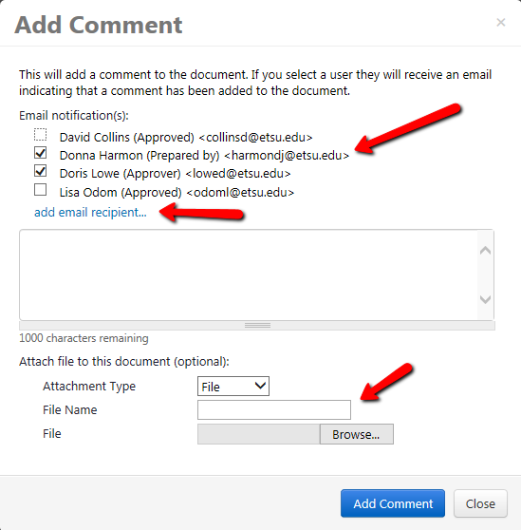
Reviewing: Add a Comment
When adding a comment, you can select recipients for your comment by checking the box by their name. When you do this, the user(s) will receive an email notifying them that a comment has been added (note: this does not make the comment private for only that user to see)
If the recipient(s) you wish to see the comment is not already listed, click “add email recipient…”
You can also add attachments to a comment (note: only PDF and Word Docs are able to be attached)
**FYI: Please note that comments can be seen by everyone and cannot be edited or deleted once submitted. **

Slide 11
Reviewing: Attachments Tab
On the Attachments tab, you can view the documents that have been attached to the requisition
This tab also shows whether the attachment is an Internal or External attachment
Internal attachments are only visible internally to ETSU eBucs users
External attachments are visible both internally and externally to the supplier
Approvers can add attachments if the requisition is assigned to them
Note: Refer to slide 8 for instructions on adding an attachment

Slide 12
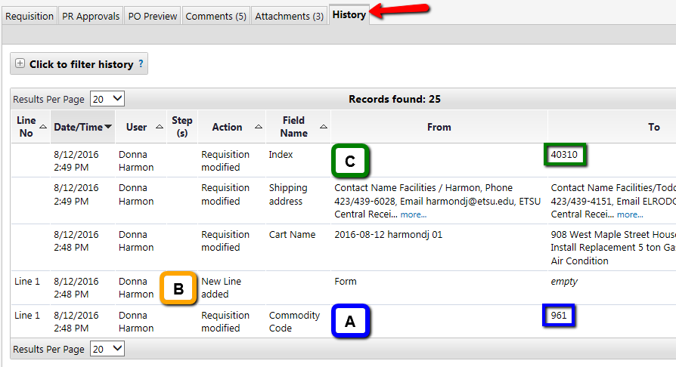
Reviewing: History Tab
The History tab is a log of everything that has been done to the requisition
This tab is read chronologically from bottom to top
History will show you when the requisition was modified, who modified it, and how it was modified Examples:
Commodity Code 961 was added on 8/12/2016 at 2:48 PM (A)
Donna Harmon added a new line on 8/12/2016 at 2:48 PM (B)
Index number E40310 was used for this requisition and added on 8/12/2016 at 2:49 PM (C)

Slide 13
Reviewing: History Tab (cont.)
The History tab will also reflect any comments, notes, or attachments that have been added to the requisition Examples:
Donna Harmon added an internal attachment on 8/16/2016 at 3:15 PM (D)
Doris Lowe added comment “To Legal for review” on 8/22/2016 at 5:17 PM (E)

Slide 14
Available Actions: Approving & Rejecting
After reviewing the requisition, you will locate the Available Actions drop down menu on the top right of the requisition
Available Actions allows you to do one of the following:
Approve/Complete Step – this approves the requisition and sends it to the next approval step in the workflow
Return to Shared Folder – this unassigns the requisition from you and returns it to the shared department folder under My Approvals
Return to Requisitioner – this returns the requisition to the requestor that prepared the requisition
Forward to – this allows you to forward a requisition that is assigned to you to another user. This action is used to forward a requisition between multiple approvers who may need to view the requisition before it is approved
Reject Requisition – this will reject the entire requisition

Slide 15
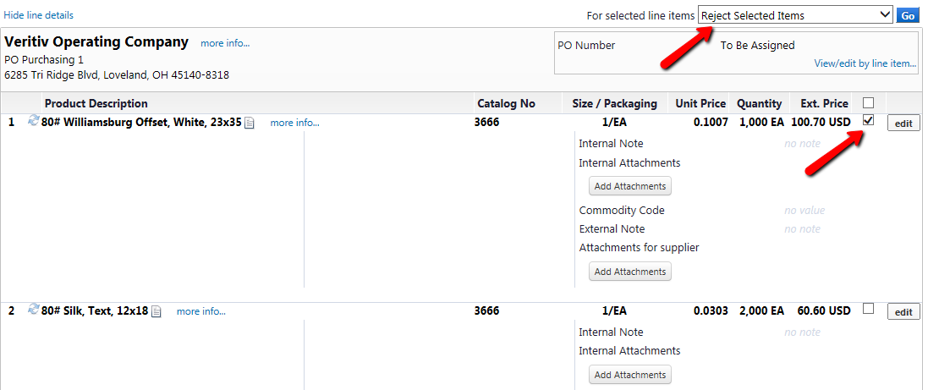
Rejecting One or More Line Items
After reviewing the requisition, you may want to only reject one or more particular items verses the entire requisition
To reject one or more items, find the line items on the Requisition Summary tab
Check the box(es) of the item(s) you want to reject
Select “Reject Selected Items” and click Go
**FYI: Some suppliers are pulled from an internal catalog. These suppliers may not allow rejection of one line item vs all items. In this case, the entire requisition will need to be rejected and resubmitted with the corrections.

Slide 16
eBucs
eBucs is ETSU’s electronic purchasing system. eBucs is hosted by a third party company called JAGGER, which is a partner of Banner. eBucs interfaces with Banner to check budgets and create encumbrances for the University’s purchasing needs.
Should you have additional questions regarding the approval process, training sessions are available or you can contact Purchasing for assistance at 439-4224.

